Slide 1


Lighting Council New Zealand
Engineering NZ – Electrical Engineering Group – 6 August 2025
Chris Byrne – Chair
Bryan King - Executive Director

Slide 2


Presentation Overview
The role and purpose of Lighting Council New Zealand
LCNZ work on NZS, AS/NZS, IEC, ISO technical committees
LCNZ contribution to lighting product and application standards
LCNZ advocacy work with government policymakers and regulators
New and emergent lighting topics

Slide 3
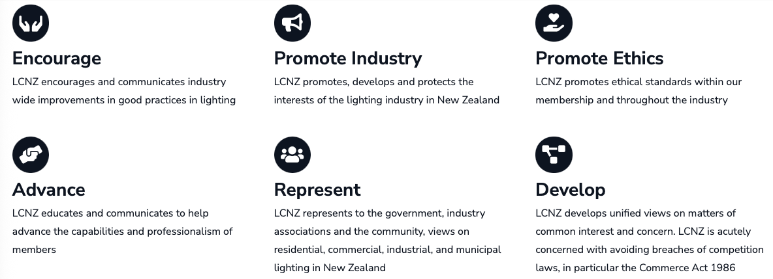
LCNZ - Who we are
An industry association for lighting equipment and services companies
An Incorporated Society with 28 member companies, established in 2003
Full Members – Lighting product manufacturing or importing companies
Associate Members – Lighting related products or services companies

Slide 4
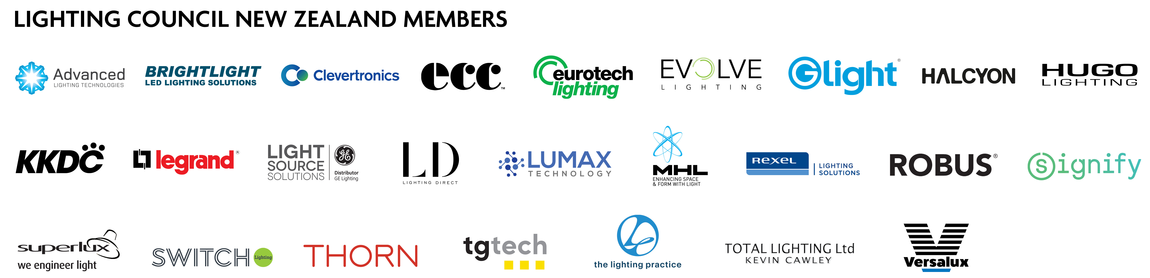
LCNZ – Who we are

Slide 5
LCNZ - What we do
LCNZ is very active in technical and commercial affairs:
Participation and advocacy in local and international standards
Technical expertise for local and international standards
Technical and commercial monitoring and surveillance
Advocacy submissions to government policymakers
Government regulatory input and collaboration
International best practice information dissemination
Training and education
Our purpose is to be the key contact point for all lighting industry matters

Slide 6


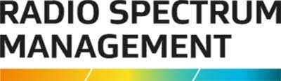



Government Collaboration
LCNZ shares information with a wide range of Government Organisations:
EECA – Product and building energy performance
Worksafe NZ – Electrical, mechanical, thermal, and radiation safety
MBIE-BSP – Electric lighting, daylighting, emergency lighting, energy performance
MBIE-RSM – Electromagnetic compatibility, radio transmission
MfE – Waste management, hazardous substances, emissions reporting
NZTA – Road and public lighting

Slide 7






NGO Collaboration
LCNZ shares information with a wide range of Non-Government Organisations:
IESANZ – Illuminating Engineering Society of ANZ
EngNZ-EEG – Engineering NZ - Electrical Engineering Group
ME – Master Electricians NZ
CEP - Carbon and Energy Professionals NZ
NZGBC – NZ Green Building Council
IRHACE – Institute of refrigeration, heating, and air conditioning engineers NZ

Slide 8


Jointed AS/NZS Standards – Local
+
AS/NZS Product Standards
Light sources
Luminaires
Control gear
Lighting systems
AS/NZS Application Standards
Lighting design
Emergency lighting
Obtrusive light
Lighting energy

Slide 9
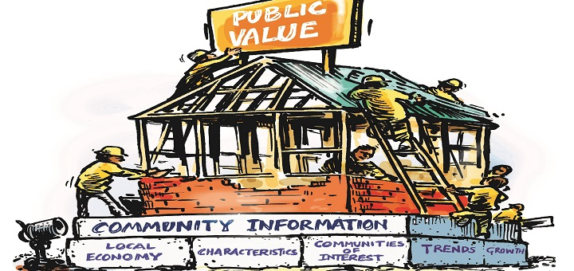


The AS/NZS de-jointing challenge
NZ Treasury Reform of Standards NZ in 2014-15
The introduction of the NZ Standards and Accreditation Act 2015
The repeal of the Standards Act 1988
Rapid de-jointing is underway unless commissioning fees are paid to Standards Australia

Slide 10
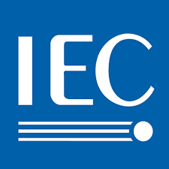
Standards – International
IEC Product Standards
Light sources
Luminaires
Control gear
Lighting systems
Environmental design
Connectivity & Comms
ISO Application Standards
Lighting design
Lighting energy
Emergency lighting
System commissioning
Daylight design
Building Modelling

Slide 11

Product Standards
IEC TC 34 Lighting Committee
NZ IEC National Committee:
NZ is an IEC TC34 ‘P-Member’ with a NZ ISO voting rights
New topics:
Modular luminaire eco-design, connectivity interfaces
Communication of IoT systems, interoperability, cybersecurity
Luminaire BIM
Life Cycle Assessment (LCA) Environmental Product Declarations (EPD)
Material efficiency, circularity, repairability, remanufacture, end of life
Carbon footprinting of products

Slide 12
Application Standards
ISO TC 274 Light and Lighting Committee
NZ ISO National Committee
NZ is an ISO TC 274 ‘P-Member’ with a NZ ISO voting rights
New topics:
Lighting design with adaptive lighting systems
BIM simulation for design and asset management
Adaptive lighting energy and emissions calculation
Daylight application
Commissioning of lighting systems
Energy Performance of Buildings (EPB) - ISO 52000 EPB series

Slide 13
Who pays for NZ International representation?
IEC TC 34 Lighting Committee
LCNZ – Funds F2F for all meetings, and annual NZ NC fee
Worksafe NZ - Funds some regulated IEC to NZS adoptions
ISO TC 274 Light and Lighting Committee
LCNZ - Funds full face-to-face for all meetings
IESANZ – Funds virtual and one F2F meeting
EECA – Funds virtual and some ISO to NZS energy standards
MBIE-BSP – Funds annual NZ NC fee

Slide 14

Global Lighting Association
The association for lighting associations globally - 38 member countries
Information sharing and education
Joint advocacy for coherent and globally aligned public policy and regulation
Current Working Groups:
1) Light at Night 2) Product Repairability 3) PFAS Chemicals in materials

Slide 15


The Big Picture Future Challenge
In the future world of integrated lighting systems and regulated outcome reporting,
lighting professionals will need to deliver whole-of-life systemic outcomes:
Design + Luminaires + Controls + Installation + Commissioning + Operation + Maintenance = Outcomes
How will lighting delivery business models evolve to achieve this?

Slide 16

Tha
Thank you ….. Chris Byrne and Bryan King
Lighting Council New Zealand Inc
PO Box 25-229 St Heliers
Auckland 1740,
New Zealand
w: www.lightingcouncil.org.nz
e: admin@lightingcouncil.org.nz

